Slide 1
Lecture 9
UMG 101

Slide 2
Lecture Goals and Outcomes
The goals of this lecture are to
Present Unreal Motion Graphics (UMG)
Explain the Widget Blueprint
Show how to create a Title screen using UMG
Show how to create a HUD using UMG
By the end of this lecture you will be able to
Create a simple Title screen
Make the transition from the Title screen to a game Level
Create a simple HUD
Access variables from the Player Character Blueprint to use in the HUD Widget Blueprint

Slide 3
Umg concepts

Slide 4
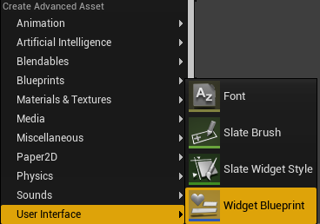
umg
The Unreal Motion Graphics (UMG) UI Designer is used to create user interface elements such as Title screens and HUDs in Unreal Engine 4.
To work with UMG, it is necessary to create a Widget Blueprint, which is a specialized type of Blueprint that contains widgets and the Designer panel.
To create a Widget Blueprint, click the green Add New button in the Content Browser, and in the User Interface submenu select “Widget Blueprint”.

Slide 5
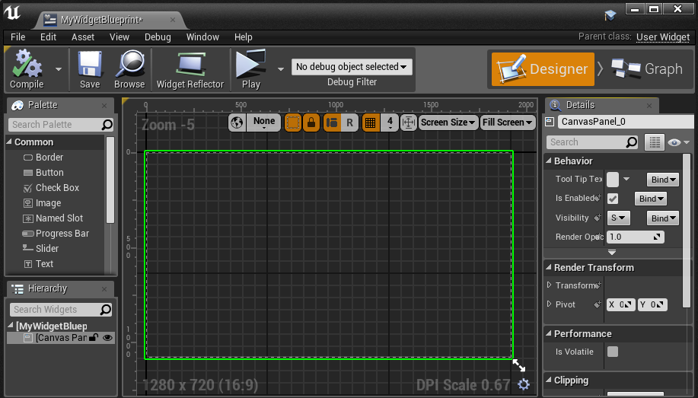
Designer Panel
A Widget Blueprint has two modes:
The Designer mode allows the creation of the visual layout using the Designer panel.
The Graph mode is where the logic of the widgets is created.
Widgets from the Palette panel can be dragged and dropped into the Designer panel.
A widget can be placed inside another widget.
The hierarchy of the widgets is displayed in the Hierarchy panel.

Slide 6
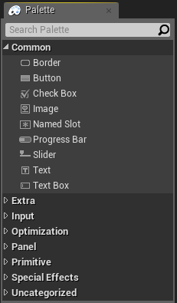
widgets
Widgets are interface components. They are added to a Canvas panel and edited in a Widget Blueprint.
The image on the right shows some common widgets found in the Designer mode’s Palette panel.

Slide 7
Title screen

Slide 8
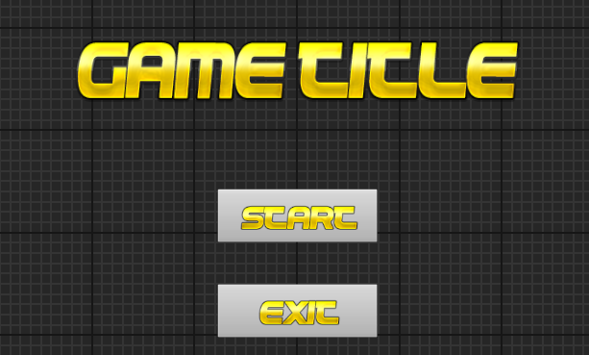
simple title screen
It is easy to create a simple Title screen using only Image and Button widgets.
The example seen on the right has two buttons, one for starting the game and the other for exiting the game.

Slide 9
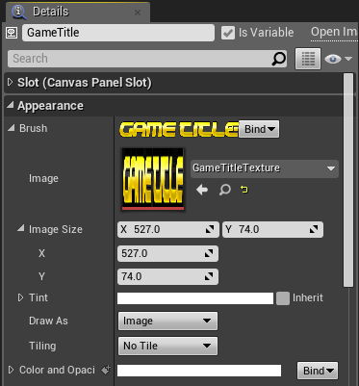
Game Title image
To create the sample Title screen, first import the textures that will be used. Then create a Widget Blueprint and name it “TitleScreenUMG”. Double-click it to open the UMG Editor.
Drag an Image widget from the Palette panel and drop it into the Designer panel. Name it “GameTitle”. In the Details panel for the widget, expand the Brush property in the Appearance category, click the Image drop-down, and select the Texture that will be used.
Resize and position the GameTitle widget in the Designer panel until it’s centered and looks good.

Slide 10
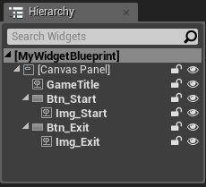
Buttons with image
Drag a Button widget from the Palette panel and drop it into the Designer panel. Name it “Btn_Start”. Next drag an Image widget onto the Btn_Start widget. Name the Image widget “Img_Start”.
Select the Img_Start widget, and in the Details panel expand the Brush property in the Appearance category, click the Image drop-down, and select the Texture that will be used.
Create another Button widget and Image widget for the Exit button. Name the Button widget “Btn_Exit” and the Image widget “Img_Exit”. Place the Exit button widgets below the Start button widget in the Designer panel.
Resize and position the buttons in the Details panel. Set Size X to “250” and Size Y to “84” for both buttons.
The image on the right shows the Hierarchy panel with the widgets that were added.

Slide 11
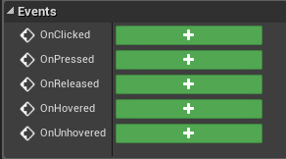
On Clicked event
Select one of the buttons, and in the Details panel expand the Events category and add an OnClicked event.
Do the same for the other button.

Slide 12
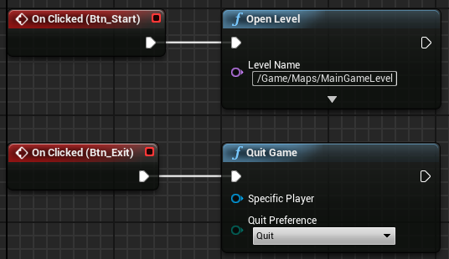
Button actions
The On Clicked events for the buttons are added to the Event Graph of the Widget Blueprint.
The Start button opens the main game Level to start the game.
The Exit button calls the Quit Game function.

Slide 13
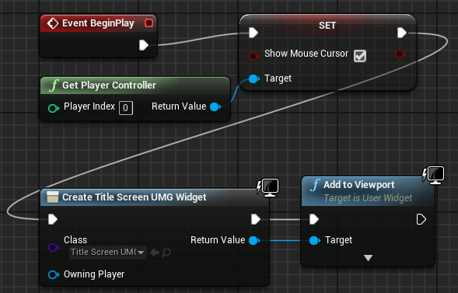
Using the title screen
To use the Widget Blueprint for the Title screen, create a new Level and set it as the default map.
In the Level Blueprint, duplicate the node graph shown in the image on the right.
The graph enables the mouse cursor, creates the Widget Blueprint object, and then adds the Widget Blueprint object to the Viewport.

Slide 14
hud

Slide 15
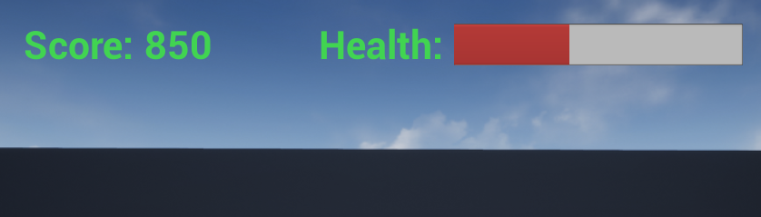
Hud widget blueprint
UMG can also be used to create HUDs (heads-up displays). A HUD is used to visually relay information to the player during gameplay.
In the example on the right, a HUD displays the Score value as text and the Health value as a progress bar.
Score and Health are variables that need to be created in the Player Character Blueprint.
Create a Widget Blueprint and rename it “HUD_UMG”. Double-click it to open the UMG Editor.

Slide 16
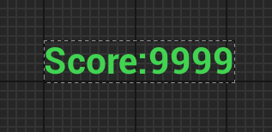
Hud text
Let’s start with the Score value. Drag a Horizontal Box widget from the Panel category of the Palette panel and drop it near the upper left corner of the Designer panel.
Next, drag two Text widgets onto the Horizontal Box widget.
Select the first Text widget, and in the Details panel set the value of the Text property to “Score:”.
Select the second Text widget and set the value of the Text property to “9999”.
Choose a green color and set the font size to “48” for both Text widgets.

Slide 17
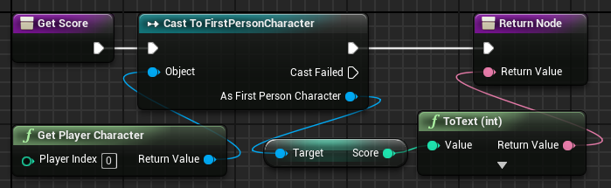
Get Score function
Select the Text widget with the value “9999”. In the Details panel, click the Text property’s Bind drop-down and select “Create Binding” to create a new function.
The value of the Text widget’s Text property will be bound to the return value of the new function. Rename the function “GetScore” and duplicate the graph seen in the image on the right.
This example uses the FirstPersonCharacter class of the First Person template. The Score variable was added to the FirstPersonCharacter class.

Slide 18

Hud progress bar
A progress bar will be used to display the status of the Health variable.
Drag a Horizontal Box widget from the Panel category of the Palette panel and drop it near the top center of the Designer panel.
Next, drag a Text widget onto the Horizontal Box widget. Set the Text widget’s Text property to “Health: ”, choose a green color, and set the font size to “48”.
Drag a Progress Bar widget onto the same Horizontal Box widget. Change the fill color to red. The Percent property value ranges from “0.0” to “1.0” and sets the current value of the progress bar.

Slide 19
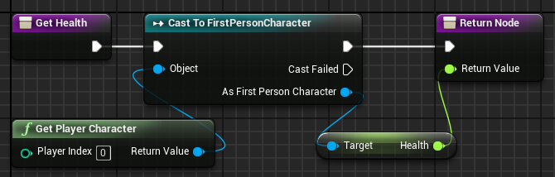
Get health function
Select the Progress Bar widget. In the Details panel, click the Percent property’s Bind drop-down and select “Create Binding” to create a new function.
The value of the Progress Bar widget’s Percent property will be bound to the return value of the new function. Rename the function “GetHealth” and duplicate the graph seen in the image on the right.
The Health variable was added to the FirstPersonCharacter class.

Slide 20
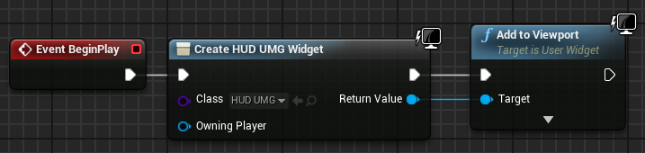
Using the hud
To use the HUD Widget Blueprint, open the Level Blueprint for the game Level and duplicate the node graph shown in the image on the right.
The graph creates the Widget Blueprint object and then adds it to the Viewport.

Slide 21
summary
This lecture presented Unreal Motion Graphics (UMG) and the Widget Blueprint.
It showed how to create a Title screen and a HUD using UMG.

